Slide 1
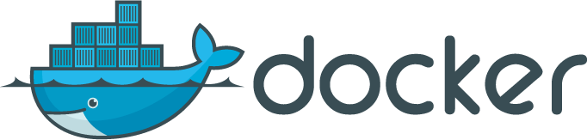
Compose, Machine and Swarm

Slide 2
Compose
One binary to start/manage multiple containers and volumes on a single Docker host
Originated from Fig
Move your lengthy docker run
commands to a YAML file

Slide 3
Installation
Via pip
Or just get the binary
$ sudo curl -L https://github.com/docker/compose/releases/download/1.1.0/ docker-compose-`uname -s`-`uname -m` > /usr/local/bin/docker- compose

Slide 4
Use
$ docker-compose up -d Creating vagrant_mysql_1...
Creating vagrant_wordpress_1...
$ docker-compose ps
Name Command
Ports
State
vagrant_mysql_1 3306/tcp | /entrypoint.sh | mysqld | Up
vagrant_wordpress_1 0.0.0.0:80->80/tcp | /entrypoint.sh | apache2-for ... | Up

Slide 5
YAML description
wordpress:
image: wordpress links:
mysql ports:
- "80:80"
environment:
WORDPRESS_DB_NAME=wordpress
WORDPRESS_DB_USER=wordpress
WORDPRESS_DB_PASSWORD=wordpresspwd mysql:
image: mysql volumes:
/home/docker/mysql:/var/lib/mysql environment:
MYSQL_ROOT_PASSWORD=wordpressdocker
MYSQL_DATABASE=wordpress
MYSQL_USER=wordpress
MYSQL_PASSWORD=wordpresspwd

Slide 6
Machine
One binary to create a remote Docker host and setup the TLS communication with your local docker client.
Automates the TLS setup and the configuration of the local environment
Can manage multiple machines in different clouds at the same time

Slide 7
Installation (e.g OSX)
$ wget https://github.com/docker/machine/releases/download/v0.1.0/docker
-machine_darwin-amd64
$ mv docker-machine_darwin-amd64 docker-machine
$ chmod +x docker-machine
$ ./docker-machine --version docker-machine version 0.1.0

Slide 8
Local Use
$ docker-machine ls
NAME ACTIVE
dev *
DRIVER
virtualbox
STATE URL SWARM
Running tcp://192.168.99.100:2376
$ docker-machine env dev export DOCKER_TLS_VERIFY=1 export
DOCKER_CERT_PATH=/Users/sebastiengoasguen/.docker/machine/machine s/dev
export DOCKER_HOST=tcp://192.168.99.100:2376
$ docker images REPOSITORY
TAG
… CREATED
VIRTUAL SIZE
wordpress | latest | … | 2 | weeks | ago | 451.4 | MB
mysql | latest | … | 2 | weeks | ago | 282.8 | MB
mysql | 5.5 | … | 2 | weeks | ago | 214.5 | MB

Slide 9
Cloud Use
Many drivers
Many more waiting for merge (i.e cloudstack )
$ ./docker-machine create -d digitalocean foobar INFO[0000] Creating SSH key...
INFO[0001] Creating Digital Ocean droplet... INFO[0005] Waiting for SSH...
INFO[0072] Configuring Machine...

Slide 10
Swarm
•
Docker client endpoint that proxies requests to docker daemons running in a cluster.
•
Cluster manager that keeps state of the cluster nodes
•
Easily run as a container itself
•
Multiple service discoveries for cluster nodes (docker hosted, etcd, consul, zookeeper, file based)

Slide 11
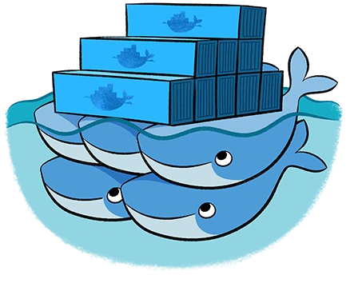
Swarm

Slide 12
Use
No install, run the container
docker pull swarm
$ docker run -v /vagrant:/tmp/vagrant -p 1234:1234 -d swarm manage file://tmp/vagrant/swarm-cluster.cfg -H=0.0.0.0:1234
72acd5bc00de0b411f025ef6f297353a1869a3cc8c36d687e1f28a2d8f422a06
$ docker -H 0.0.0.0:1234 info Containers: 0
Nodes: 3
swarm-2: 192.168.33.12:2375
└ Containers: 0
└ Reserved CPUs: 0 / 1
└ Reserved Memory: 0 B / 490 MiB
…
$ docker -H 0.0.0.0:1234 run -d -p 80:80 nginx

Slide 13
Use Machine to create Swarm
Get a token for discovery
Start nodes with machine using the --swarm
option
$ docker run swarm create 31e61710169a7d3568502b0e9fb09d66
$ docker-machine create -d virtualbox --swarm --swarm-master
--swarm-discovery token://31e61710169a7d3568502b0e9fb09d66 head
...
$ docker-machine create -d digitalocean --swarm --swarm-discovery token://31e61710169a7d3568502b0e9fb09d66 worker-00
...
$ docker-machine create -d azure --swarm --swarm-discovery token://31e61710169a7d3568502b0e9fb09d66 swarm-worker-01

Slide 14
Links
Check:
https://github.com/how2dock/docbook
Lots of Vagrantfiles and scripts to test these features
Docs:
http://docs.docker.com
https://github.com/docker/<compose,machine,s warm>

Slide 15
Conclusions
Three new Docker features to simplify:
provisioning of Docker hosts locally and in the Cloud
Management of groups of containers started on a host
Creation of cluster of Docker host and scheduling of containers in them
Merge of the three to provide “batteries included” experience will be great.
Concerns on scheduling do-over for the cluster management, fault-tolerance, scaling, etc

